Slide 1
Microprogrammed Control Unit

Slide 2
Microprogrammed Control Unit
Major functional parts in a digital computer
CPU
Memory
I/O
The CPU is made up of three major parts
1) Register Set
2) ALU
3) Control Unit

Slide 3
Microprogrammed Control Unit
Hardwired Control Unit:
When the control signals are generated by hardware using conventional logic design techniques, the control unit is said to be hardwired.
The control logic is implemented with gates, flip-flops, decoders, and other digital circuits.
Micro programmed control unit:
the control information is stored in a control memory (if the design is modified, the micro-program in control memory has to be updated)
A control unit whose binary control variables are stored in memory is called a micro programmed control unit.

Slide 4
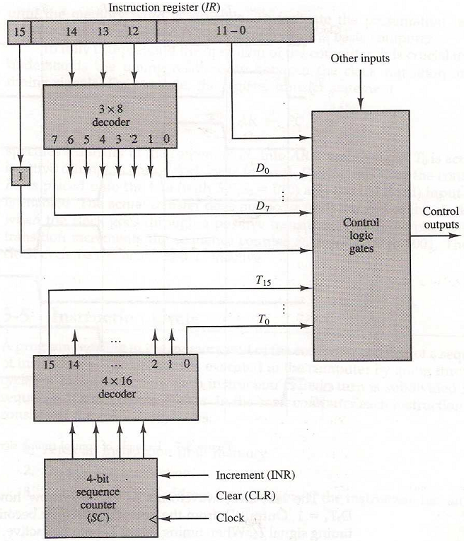
Hardwired Control Unit
Fig: Block diagram of the hardwired control unit

Slide 5
Microprogrammed Control Unit
Limitations of hardwired Control Unit:
Complete Boolean circuit
Difficult to implement for complex systems.
Impossible to add an instruction after implementing the circuit.
Alternate
Miro-programmed control unit:
The function of the control unit in a digital computer is to initiate sequences of microoperations.
The control signals associated with operations are stored in special memory units as Control Words.

Slide 6
Microprogrammed Control Unit
Control Word:
The control variables at any given time can be represented by a control word string of 1 's and 0's.
A control word is a word whose individual bits represent various control signals.
Micro-instruction :
Individual control words in the control sequence are referred to as microinstructions.
Micro-program :
A sequence of micro-instructions which is stored in a Control Memory (ROM or RAM).
Control Memory is used to store the microprogram. control memory is a part of a control unit

Slide 7
Microprogrammed Control Unit
Microoperations:
micro-operations are detailed low-level instructions used in some designs to implement complex machine instructions.
Micro instruction:
A symbolic microprogram can be translated into its binary equivalent by means of an assembler.
Each line of the assembly language microprogram defines a symbolic microinstruction.
The microinstruction specifies one or more microperations.

Slide 8
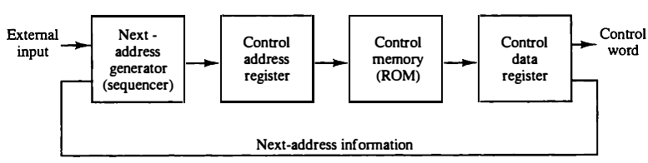
Microprogrammed Control Unit
The control memory is assumed to be a ROM, within which all control information is permanently stored.
The control memory address register specifies the address of the microinstruction, and the control data register holds the microinstruction read from memory.

Slide 9
Microprogrammed Control Unit
The microinstruction contains a control word that specifies one or more microoperations for the data processor. Once these operations are executed, the control must determine the next address.
The location of the next microinstruction may be the one next in sequence, or it may be located somewhere else in the control memory.

Slide 10
Microprogrammed Control Unit
While the microoperations are being executed, the next address is computed in the next address generator circuit and then transferred into the control address register to read the next microinstruction.
Thus a microinstruction contains bits for initiating microoperations in the data processor part and bits that determine the address sequence for the control memory.

Slide 11
Microprogrammed Control Unit
The next address generator is sometimes called a micro-program sequencer, as it determines the address sequence that is read from control memory.
Typical functions of a micro-program sequencer are incrementing the control address register by one, loading into the control address register an address from control memory, transferring an external address, or loading an initial address to start the control operations.

Slide 12
Microprogrammed Control Unit
The control data register holds the present microinstruction while the next address is computed and read from memory.
The data register is sometimes called a pipeline register.
It allows the execution of the microoperations specified by the control word simultaneously with the generation of the next microinstruction.

Slide 13
Microprogrammed Control Unit
This configuration requires a two-phase clock, with one clock applied to the address register and the other to the data register.
The main advantage of the micro programmed control is the fact that once the hardware configuration is established; there should be no need for further hardware or wiring changes.
If we want to establish a different control sequence for the system, all we need to do is specify a different set of microinstructions for control memory.

Slide 14
Microprogrammed Control Unit
This configuration requires a two-phase clock, with one clock applied to the address register and the other to the data register.
The main advantage of the micro programmed control is the fact that once the hardware configuration is established; there should be no need for further hardware or wiring changes.
If we want to establish a different control sequence for the system, all we need to do is specify a different set of microinstructions for control memory.

Slide 15
Address Sequencing
Microprogram sequencer determines the address sequence that is read from control memory.
The address of the next microinstruction can be specified in several ways, depending on the sequencer inputs.
Typical functions of a microprogram sequencer are incrementing the control address register by one, loading into the control address register an address from control memory.
Transferring an external address, or loading an initial address to start the control operations.

Slide 16
Address Sequencing
Microinstructions are stored in control memory in groups, with each group specifying a routine.
Each computer instruction has its own microprogram routine in control memory to generate the microoperations that execute the instruction.
The hardware that controls the address sequencing of the control memory must be capable of sequencing the microinstructions within a routine and be able to branch from one routine to another.

Slide 17
Address Sequencing
An initial address is loaded into the control address register when power is turned on in the computer.
This address is usually the address of the first microinstruction that activates the instruction fetch routine.
The address sequencing capabilities required in a control memory are:

Slide 18
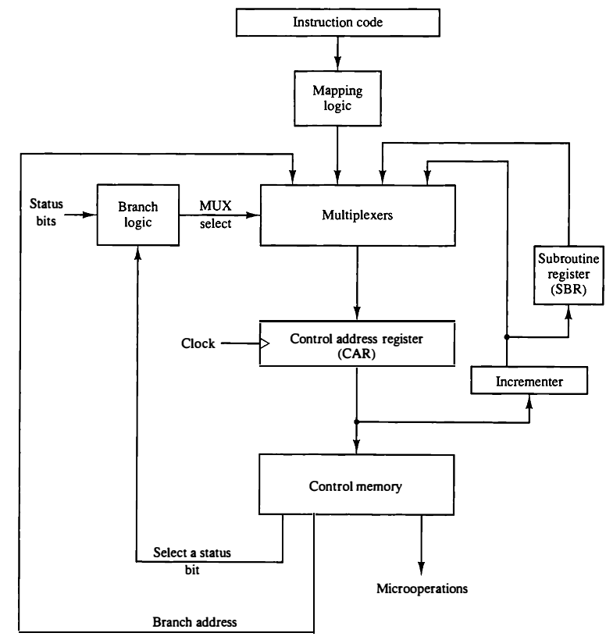
Address Sequencing
Incrementing of the control address register.
The incrementer increments the content of the control address register by one, to select the next microinstruction in sequence.
Fig: Selection of address for control memory.

Slide 19
Address Sequencing
Unconditional branch or conditional branch, depending on status bit conditions.
Branching is achieved by specifying the branch address in one of the fields of the microinstruction.
Fig: Selection of address for control memory.

Slide 20
Address Sequencing
Unconditional branch or conditional branch, depending on status bit conditions.
Conditional branching is obtained by using part of the microinstruction to select a specific status bit in order to determine its condition.
Fig: Selection of address for control memory.

Slide 21
Address Sequencing
A mapping process from the bits of the instruction to an address for control memory.
An external address is transferred into control memory via a mapping logic circuit.
Fig: Selection of address for control memory.

Slide 22
Address Sequencing
A facility for subroutine call and return.
The return address for a subroutine is stored in a special register whose value is then used when the microprogram wishes to return from the subroutine.
Fig: Selection of address for control memory.

Slide 23
Address Sequencing
Conditional Branching:
The branch logic provides decision-making capabilities in the control unit.
The status conditions are special bits in the system that provide parameter information such as the carry-out of an adder, the sign bit of a number, the mode bits of an instruction, and input or output status conditions.
Information in these bits can be tested and actions initiated based on their condition: whether their value is 1 or 0.
The status bits, together with the field in the microinstruction that specifies a branch address, control the conditional branch decisions generated in the branch logic.

Slide 24
Address Sequencing
The simplest way is to test the specified condition and branch to the indicated address if the condition is met
otherwise, the address register is incremented.
Fig: Selection of address for control memory.

Slide 25
Address Sequencing
If the selected status bit is in the 1 state, the output of the multiplexer is 1; otherwise, it is 0.
A 1 output in the multiplexer generates a control signal to transfer the branch address from the microinstruction into the control address register.
Fig: Selection of address for control memory.

Slide 26
Address Sequencing
A 0 output in the multiplexer causes the address register to be incremented.
Fig: Selection of address for control memory.

Slide 27
Address Sequencing
An unconditional branch microinstruction can be implemented by loading the branch address from control memory into the control address register.
This can be accomplished by fixing the value of one status bit at the input of the multiplexer, so it is always equal to 1.
Fig: Selection of address for control memory.

Slide 28
Address Sequencing
Mapping of Instruction:
The status bits for this type of branch are the bits in the operation code part of the instruction.

Slide 29
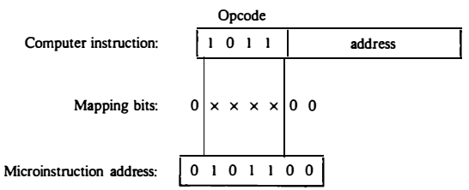
Address Sequencing
For example, a computer with a simple instruction format as shown in Fig. has an operation code of four bits which can specify up to 16 distinct instructions.
Assume further that the control memory has 128 words, requiring an address of seven bits. For each operation code there exists a microprogram routine in control memory that executes the instruction.
Fig: Mapping from instruction code to microinstruction address.

Slide 30
Address Sequencing
One simple mapping process that converts the 4-bit operation code to a 7-bit address for control memory is shown in Fig.
This mapping consists of placing a 0 in the most significant bit of the address, transferring the four operation code bits, and clearing the two least significant bits of the control address register.
Fig: Mapping from instruction code to microinstruction address.

